Slide 1
Criminal Incidents in Austin, TX 2014-2016
Group Three
Alexandar Nunu
Ali Dede
Ruben Patino
Shruthi Elkal
Subha Prashanth

Slide 2
INVESTIGATING THE NATURE OF POLICE INCIDENTS IN AUSTIN, TX
QUESTIONS WE ASKED
How safe do we feel living in this city
Which incident types occurred most frequently
How have the incidents occurring changed over time
What time of year do the incidents occur most frequently
Where have these incidents occurred throughout the city

Slide 3
TYPES OF INCIDENTS
Incident Offense Descriptions: (based off APD Data)
Theft
Burglary
Auto-Theft
Aggravated Assault
Robbery
Homicide (Murder)
Sources Used: Kaggle.com, Data.gov, Austintexas.gov

Slide 4
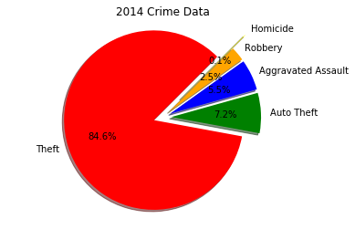
2014 Crime Data

Slide 5
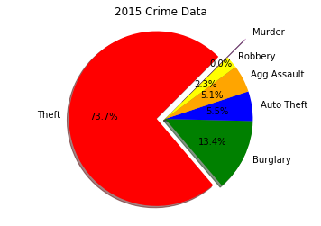
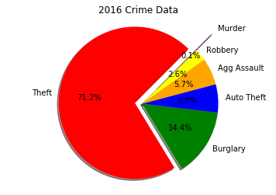
2015 & 2016 Crime Data

Slide 6
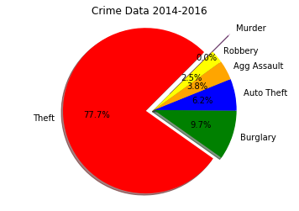
Crime Data Spanning 2014-2016

Slide 7
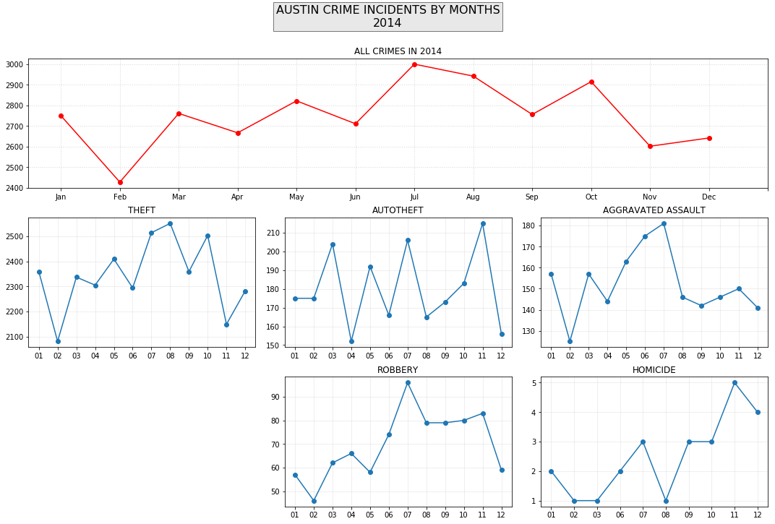
Crime Incidents by Month 2014

Slide 8
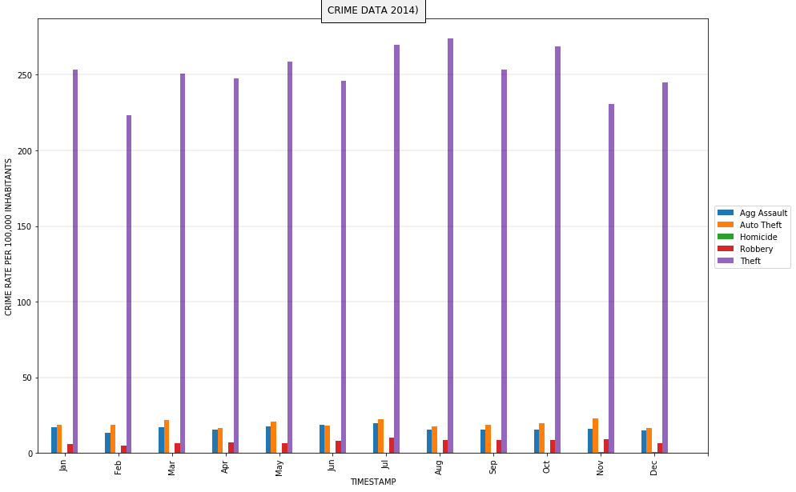
Crime Incidents by Month per 100,000 Inhabitants 2014

Slide 9
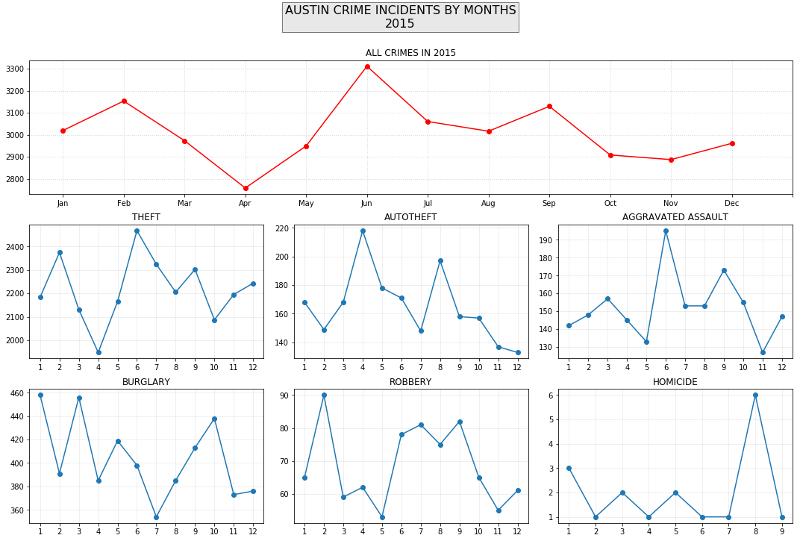
Crime Incidents by Month 2015

Slide 10
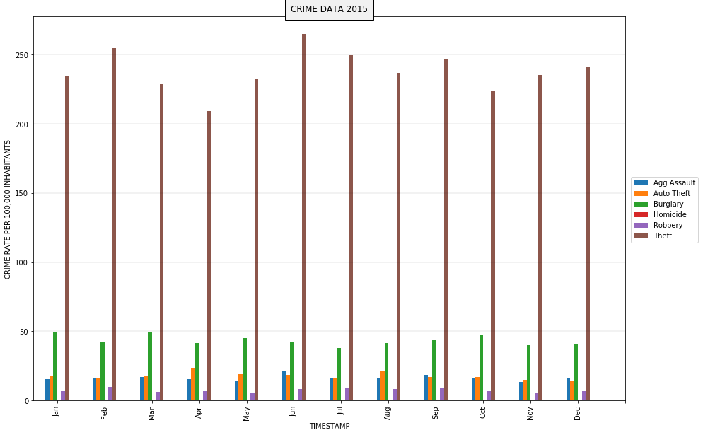
Crime Incidents by Month per 100,000 Inhabitants 2015

Slide 11
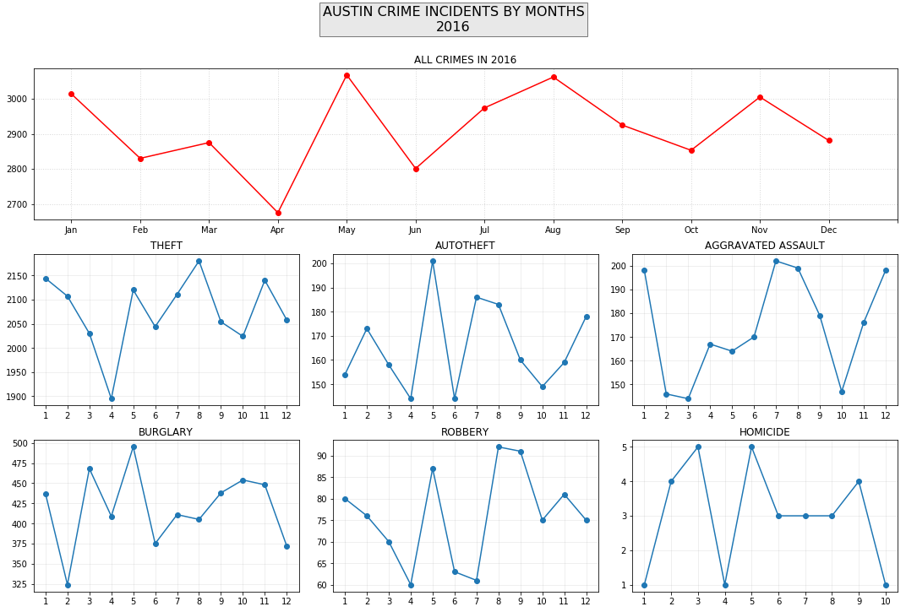
Crime Incidents by Month 2016

Slide 12
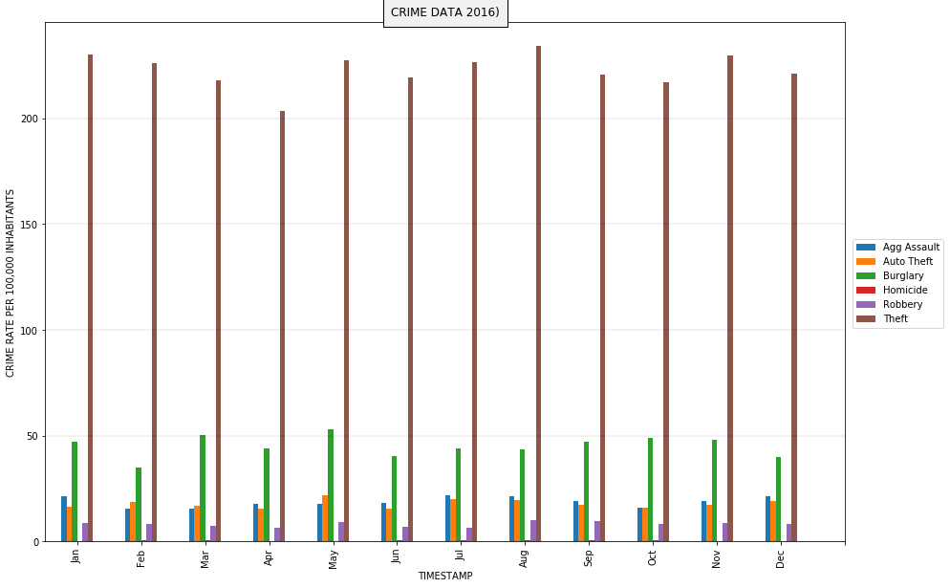
Crime Incidents by Month per 100,000 Inhabitants 2016

Slide 13
APD Crime Analysis Unit Districts (Sectors)
Austin, TX is divided into 10 Sectors
A – Adam
AP - Airport
B – Baker
C – Charlie
D – David
E – Edward
F – Frank
G – George
H – Henry
I – IDA

Slide 14
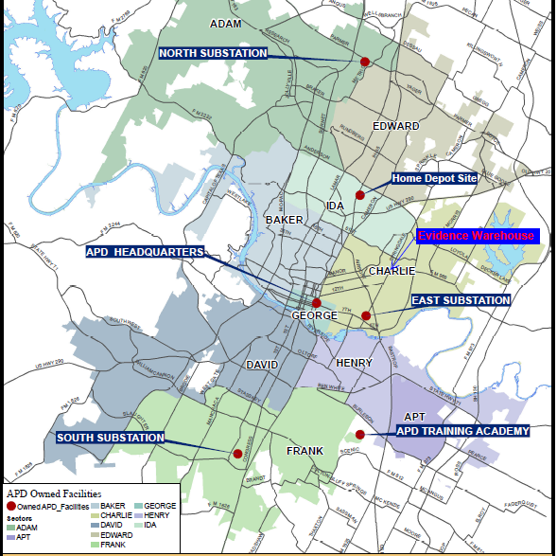

Slide 15
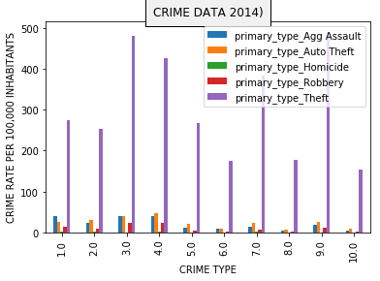
Incidents Based on District Per 100,000 Inhabitants 2014

Slide 16
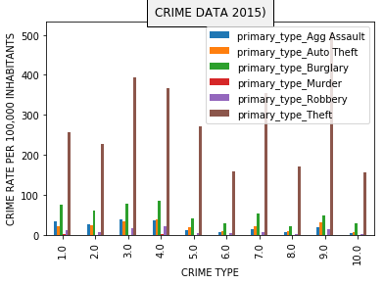
Incidents Based on District Per 100,000 Inhabitants 2015

Slide 17
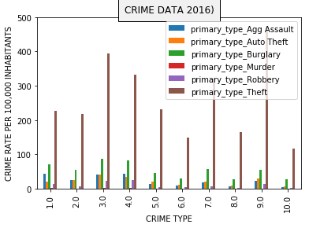
Incidents Based on District Per 100,000 Inhabitants 2016

Slide 18
Future Scope
Difficulties that arose
Questions that arose during research.
What to research next, if we had 2 more weeks.
Questions/Comments?

